Slide 1
Tokyo Exchange Stock Price Prediction
Adam Foster
Maciek Staniszewski

Slide 2
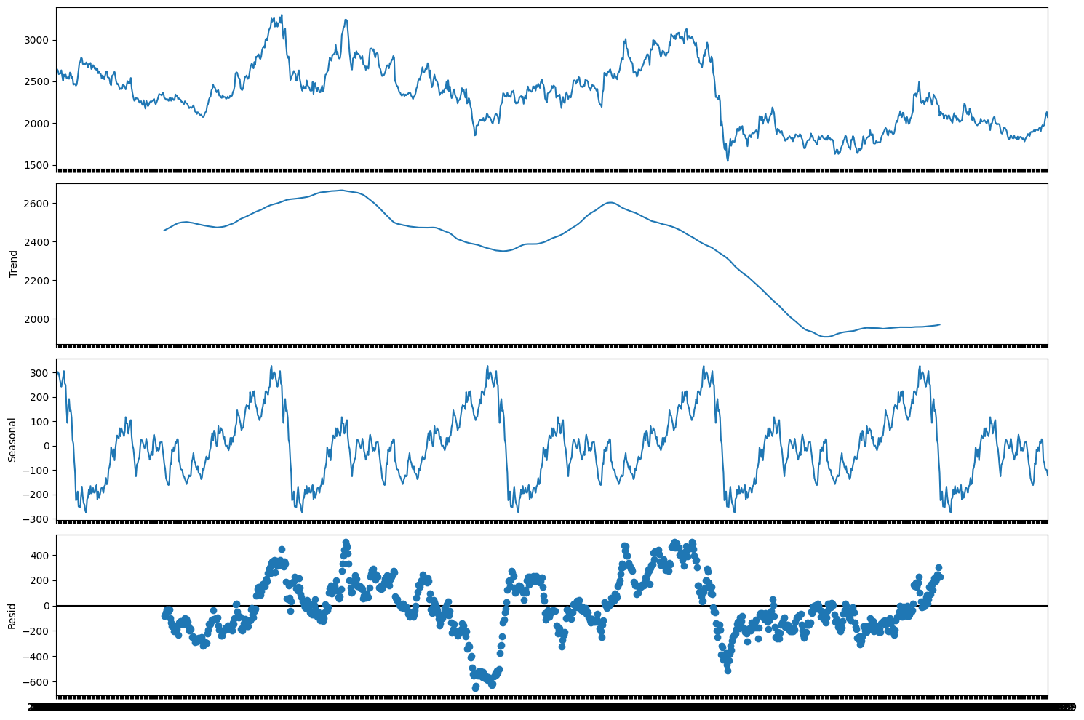
Tokyo Stock Exchange Data
Data from 2017 to 2022
Huge 1.3 GB dataset, restricted to one time series of “Japan Petroleum Exploration” – well established oil & gas company with data spanning the full period
Ensured continuous and no missing values
Predicting Close instead of Returns
Eliminating negative observations
No clear deterministic trend
Strong yearly linear seasonal effects
Residuals distributed around 0, expected for a linear model

Slide 3
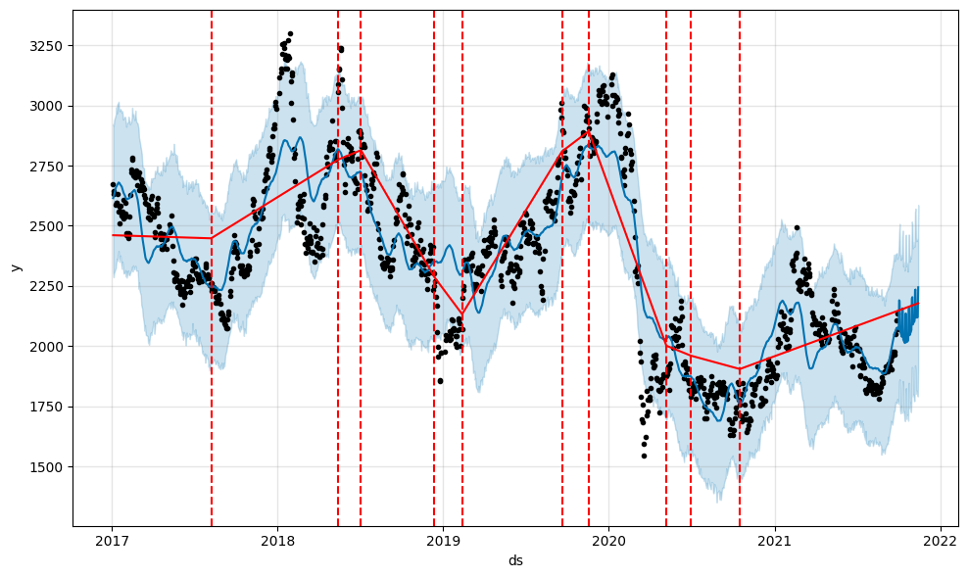

Prophet
Univariate additive model that identifies non-linear trends and seasonal effects
Last 45 observations removed from the training dataset
Prophet fits the in-sample data very well
Avoids overfitting and doesn’t accurately model sudden spikes
Models stable progressions well
Identifies 10 trend changepoints
Forecast is jumpy, but follows the general pattern.
Accounting for holidays has no effect on prediction due to how the stock market operates

Slide 4
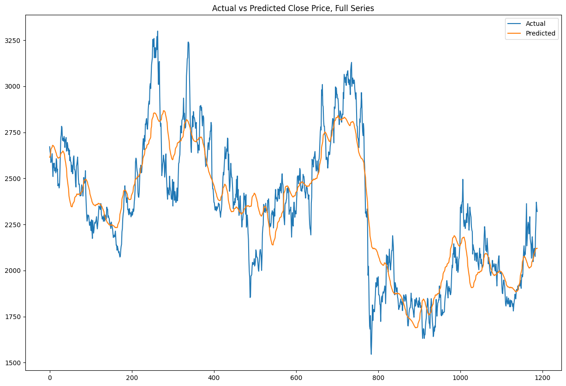
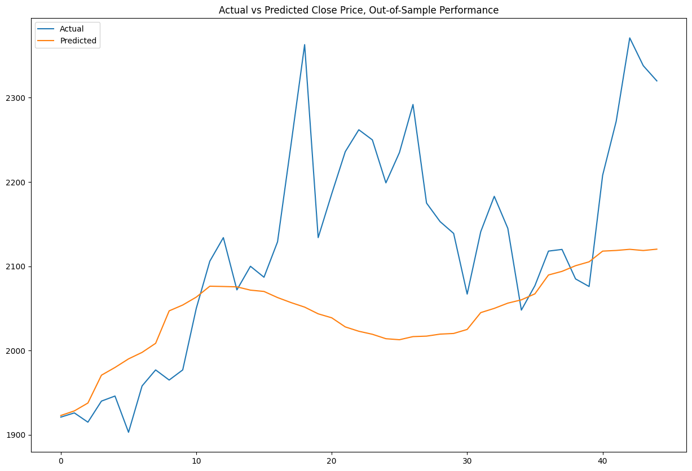
Prophet - Fitting and Predictions
MAE = 124.8, MAPE = 5.4%
MAE = 100.6, MAPE = 4.6%

Slide 5
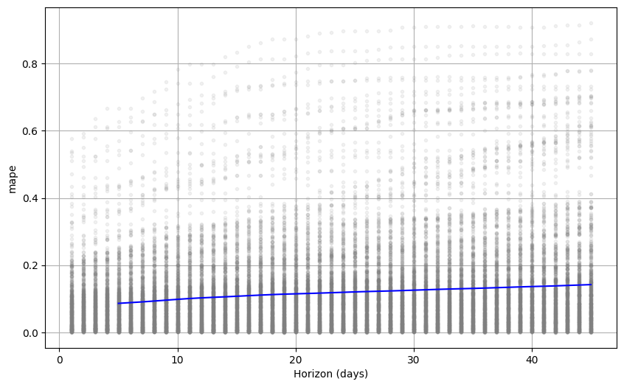
Prophet - Cross Validation
Our previous MAPE score smaller than 5% depended on favourable plateau in the Close price
The MAPE resulting from cross validation averaged at ~18%
MAPE was steadily increasing proportionally to the increase of the horizon

Slide 6

Orbit
Probabilistic Bayesian time series modelling framework.
We tested three State Space Models supported by Orbit:
Exponential Smoothing (ETS): MAPE = 6.7%
Local Global Trend (LGT): MAPE = 7.2%
Damped Local Trend (DLT): MAPE = 6.9%
All three models performed similarly in the out-of-sample period. ETS was the best at picking up a sudden price jump, while DLT was steadily trending downwards.

Slide 7
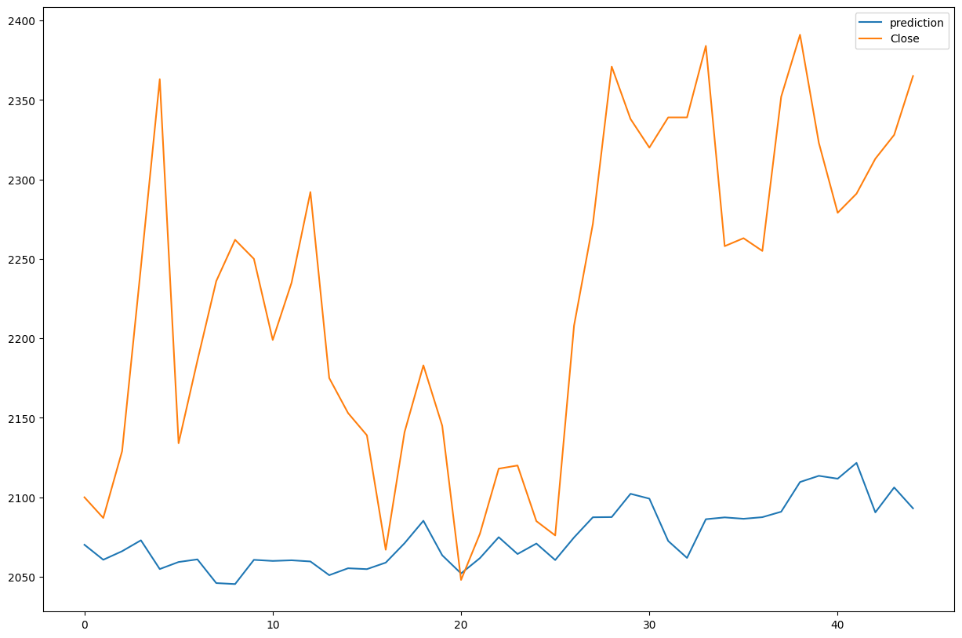
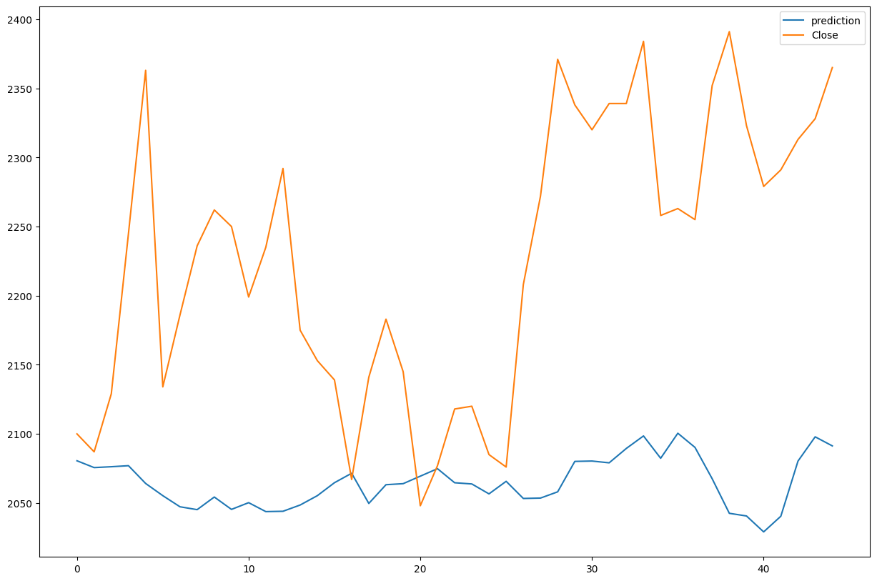
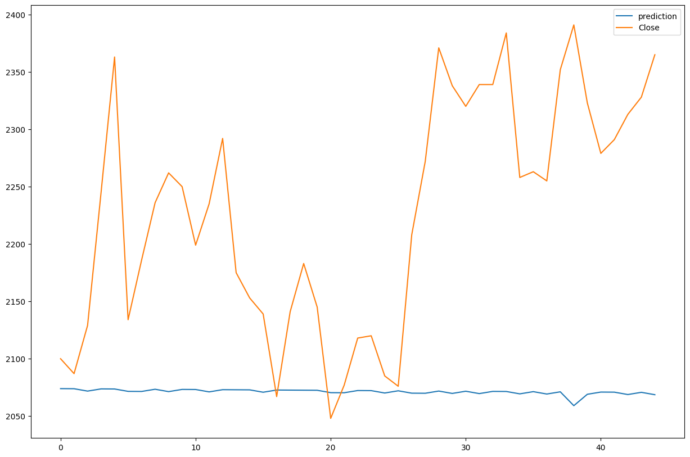
Orbit - Model Evaluation
Exponential Smoothing
Local Global Trend
Damped Local Trend

Slide 8
Conclusion
Prophet is a great tool for equity time series forecasting, requiring minimal setup and generating an exceptionally accurate forecast:
Prophet: MAPE = 4.6%
Orbit is a good alternative, ignoring some of the more pronounced spikes in data (less overfitting):
Exponential Smoothing (ETS): MAPE = 6.7%
Local Global Trend (LGT): MAPE = 7.2%
Damped Local Trend (DLT): MAPE = 6.9%

